Slide 1


FINAL
PRESENTATION
MAY 9, 2023

Slide 2







THE TIMELINE
JANUARY
FEBRUARY
MARCH
APRIL
MAY
January 20
March 20
May 9
May 10
Kick-off Meeting
Midterm Progress Presentation
Final Presentation
Finale
Event
Preliminary Research on Banner Health
Deep Dive into Data Cleaning, Analysis and Visualization
Midterm Presentation
Build a Strategic Roadmap
&
Cost vs. Savings Matrix
Final Presentation and Deliverables Handover

Slide 3
01
Data Preprocessing
02
Data Analysis
Our Agenda
03
Recommendations
Our goals, where we are, and where we're headed
04
Implementation
05
Cost & Savings
06
Final Reflections

Slide 4

The
Scope
To address financial limitations and analyze and determine ways to prolong the lifespan of endpoint devices

Slide 5





THE FACTS
370+ RESEARCH HOURS
907+
WORK
HOURS
5 MAJOR DATA REPOSITORIES
42,000+ DATA POINTS AFTER CLEANING

Slide 6
DEFINING SCOPE & GOALS
1
ANALYZE DESKTOP DEVICE FAILURES
Create a benchmark of desktop device failures by studying
1 year desktop service-ticket data.
2
DEVELOP A PROACTIVE APPROACH
Generate a proactive approach that predicts any possible
issues or downtime in the devices.
3
BUILD COST AND SAVINGS MATRIX
Develop a cost and savings matrix to show the importance
of changing the approach in device failure support.

Slide 7

Research

Slide 8



ANALYZING THE INFORMATION
170+ RESEARCH HOURS
5 MAJOR DATA REPOSITORIES
110,000+
UNCLEANED
DATA POINTS
42,000+ DATA POINTS AFTER CLEANING

Slide 9


BUILDING A MODEL
ORGANIZE DATA
1
PERFECT VS IMPERFECT
CLEAN
DATA
2
THE OBJECTIVES
CREATE MODEL

Slide 10

Data
Pre-Processing

Slide 11
UNDERSTANDING THE ISSUES
Descriptive Columns
Incomplete or Missing Data
task.short description
Computer is not working properly. It does not function correctly
Keyboard not working, tried different keyboard. Cannot access computer Ctrl/ALT/Delete not able to enter computer no keyboard function
Need TEAMS App Downloaded and need phone line reset
I need a new mouse and privacy screen
CI | Model | Purchase Date
phx1820664 | Dell Inc optiplex 7050
PHX1811386 | Dell Inc. Optiplex 7040 MT
tus120400770 | Lenovo 20W1S20N00
1cpf3k7026 | Lenovo 20W1S20N00

Slide 12
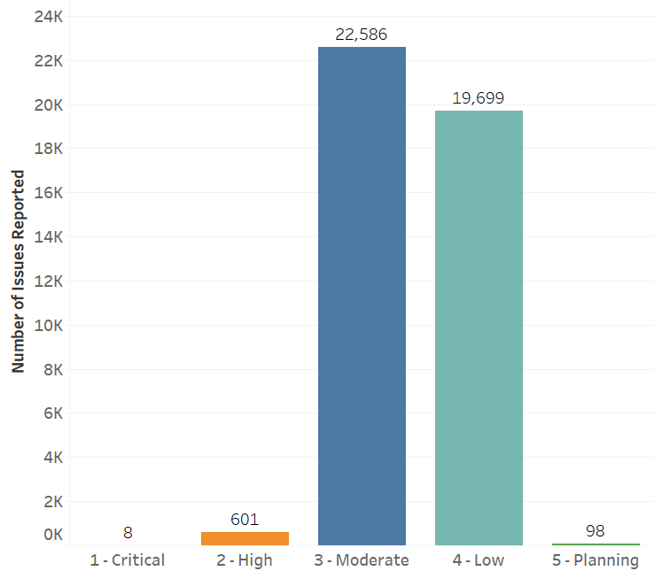
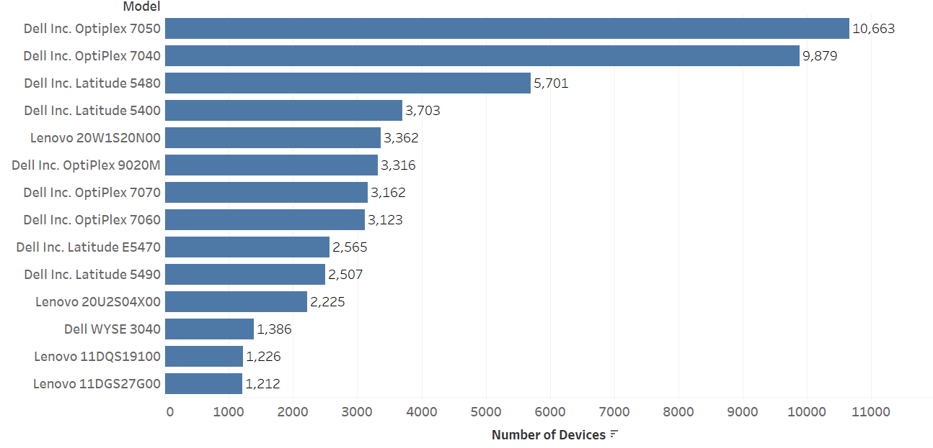
TARGETING SKEWED DATA
Highest Number of Devices
Priority of Issues

Slide 13
INCONSISTENT DATA
Software vs. Hardware Issues
CI Item Category | Ci Item.Category
Hardware | 42,977
Software | 14
CI Item Category | Task Short Description
Hardware | User needs all her software transferred from old laptop to new laptop
Hardware | Need IT assistance in person to help navigate and upload info from a USB to software on the computer
Hardware | needed admin credentials for software install

Slide 14
OUTLIERS IN THE DATA
task.number | ci_item | sys_created_on | purchase_date | AGE
INC2806741 | phx120089850 | 7/6/2021 13:20 | 8/5/2021 | -0.0532
INC3184548 | tus120158704 | 12/28/2021 15:04 | 11/19/2021 | 0.1085
INC3464729 | ThinkPad T14 Gen 2 | 5/6/2022 8:52 | 6/20/2022 | -0.1222
task.number | sys_created_on | task.ref_incident.resolved_at | Time taken_to_resolve_in minutes)
INC2581157 | 9/21/22 7:48 | 3/31/21 11:15 | -775962.6667
INC2616787 | 9/16/22 13:54 | 4/16/21 13:53 | -745921.2333
INC2719601 | 11/18/22 9:10 | 6/8/21 16:34 | -759875.9833
INC2574501 | 9/7/22 12:38 | 3/29/21 8:48 | -759110.2667

Slide 15

Data Points

Slide 16
OUTLINING THE DATA
3.5
YEARS
Average Device Age
1085 MINUTES
Average Resolution Time for Issues
Number of Locations where Issues were Reported
Number of Models Used
187
91

Slide 17

Data Analysis & Visualization

Slide 18
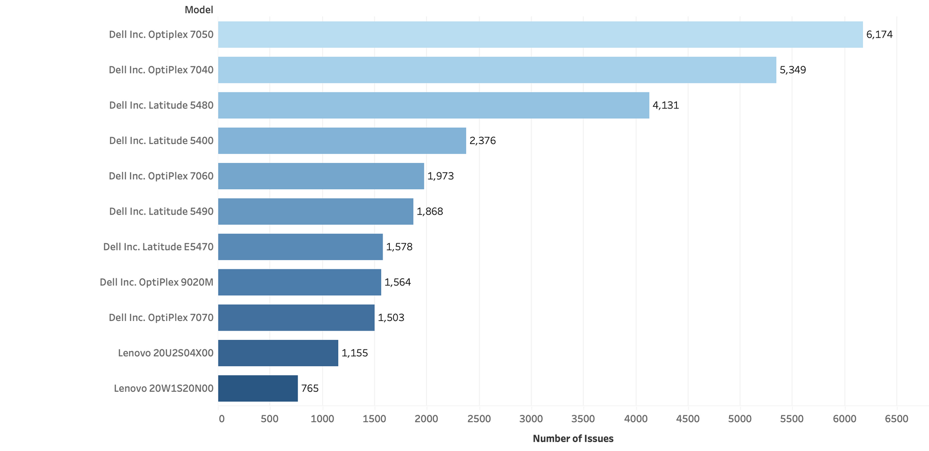
RANKING THE MODELS

Slide 19
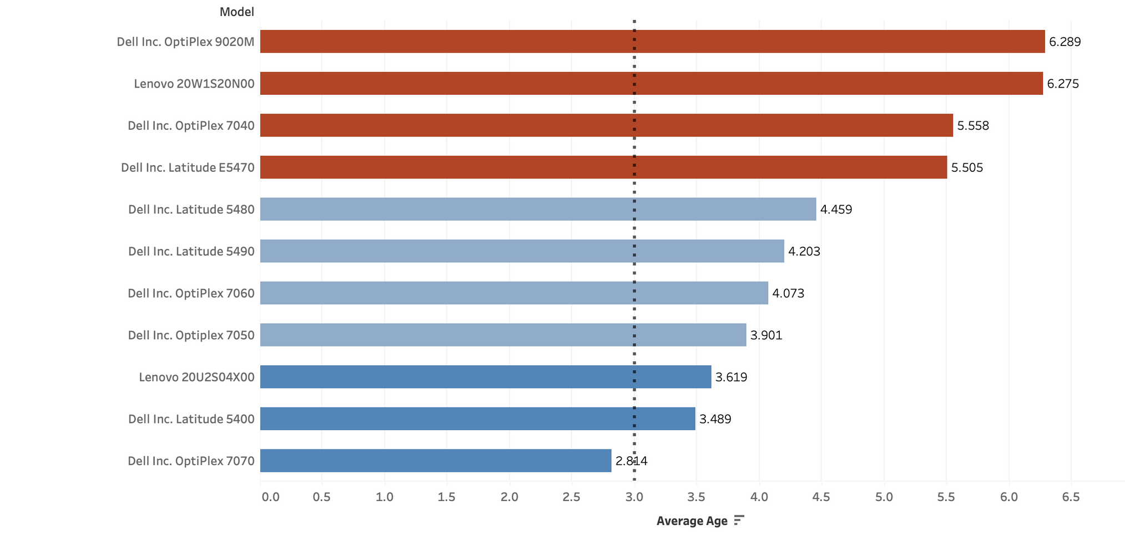
AVERAGE AGE OF MODELS

Slide 20
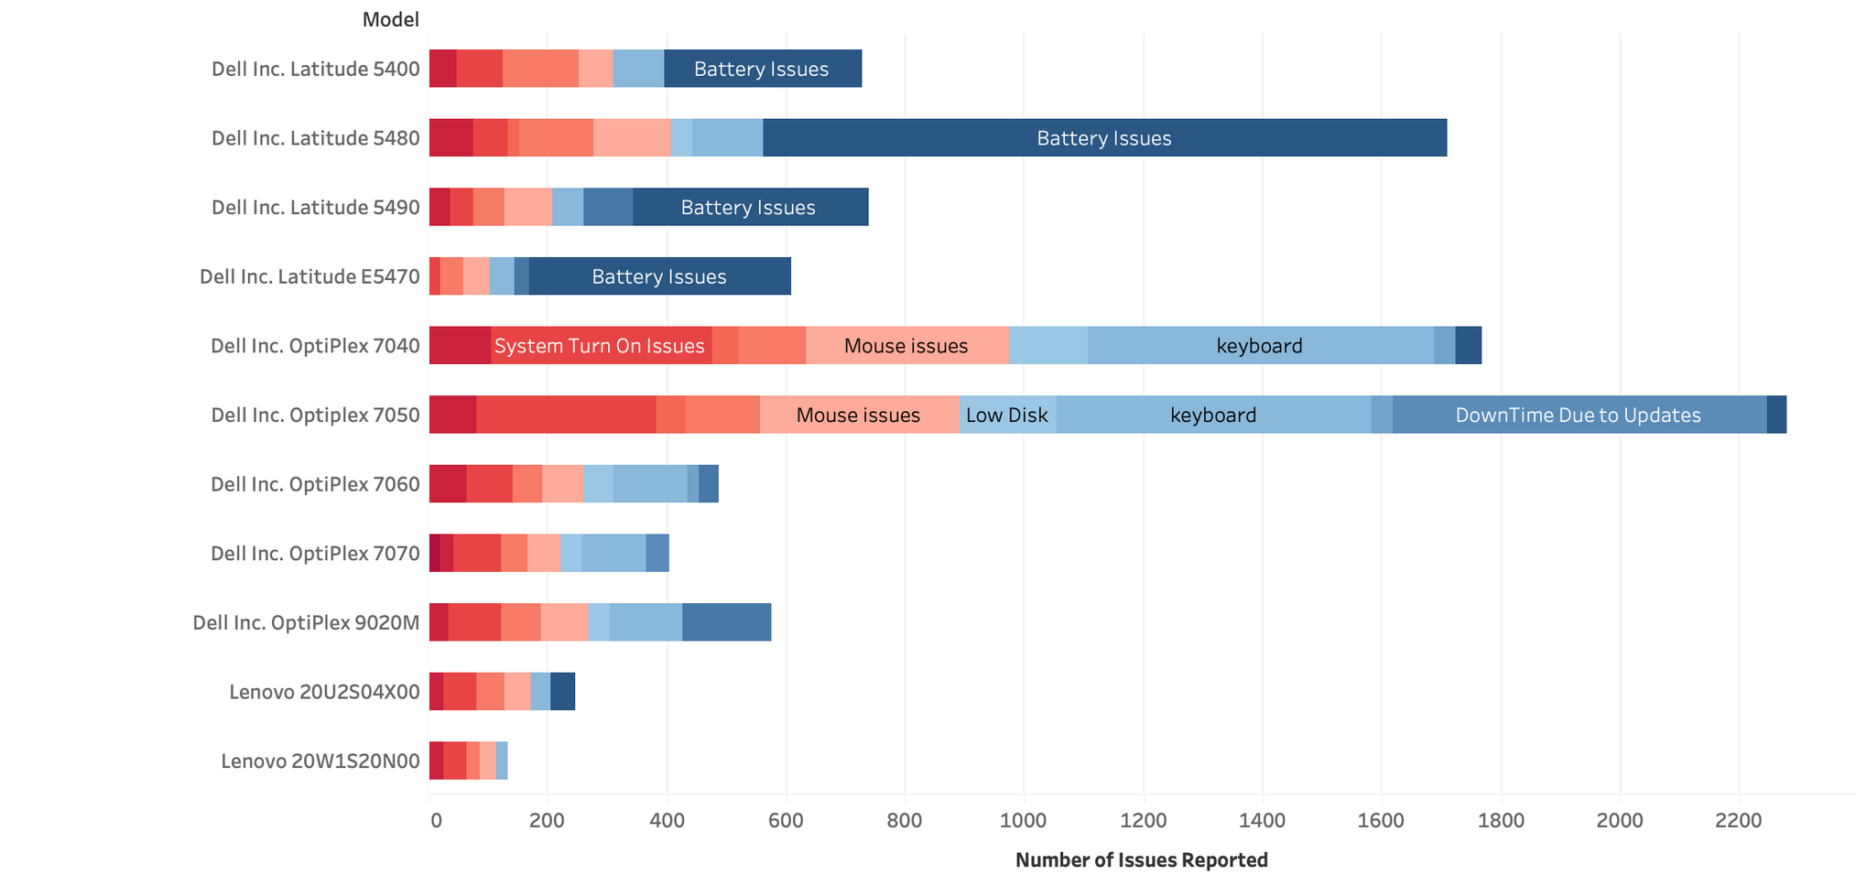
MAJOR ISSUES PER MODEL

Slide 21
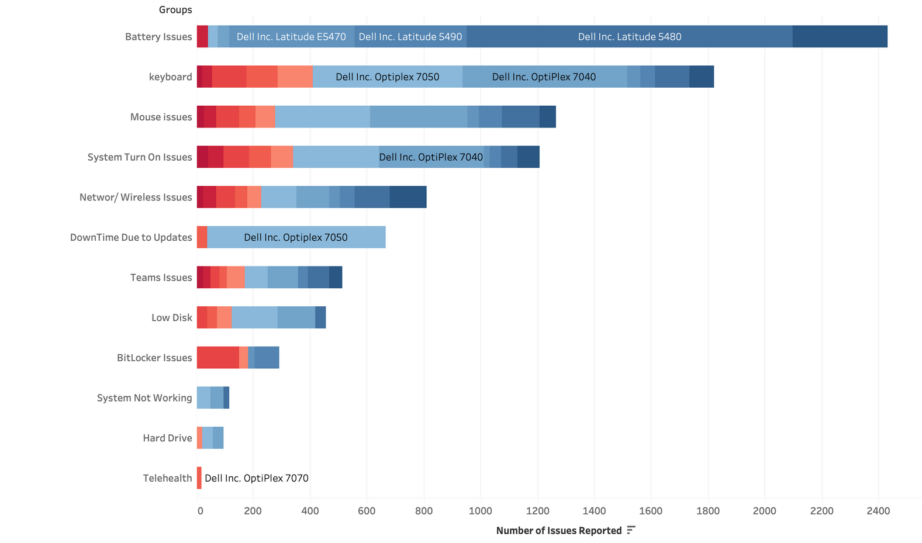
TYPES OF ISSUES BY MODELS

Slide 22
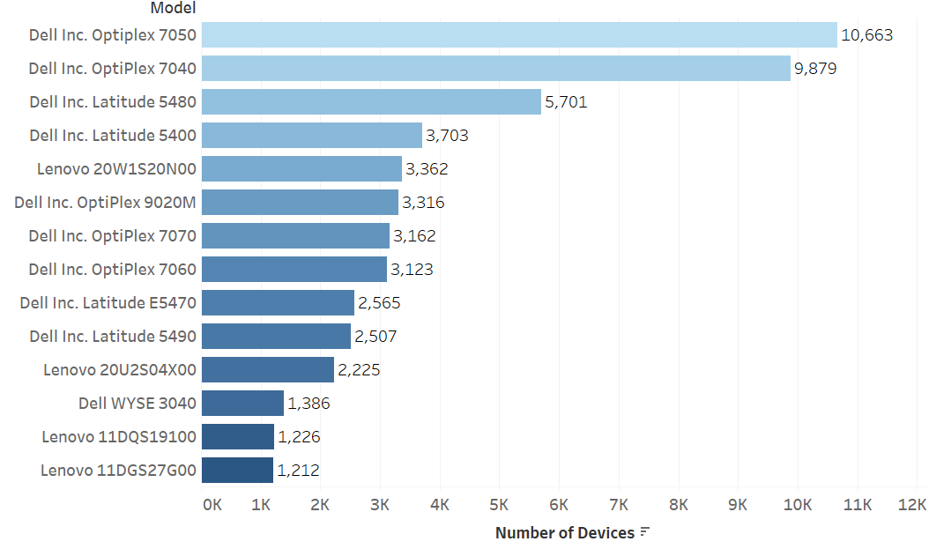
REPORTED ISSUES VS DEVICE MODELS

Slide 23
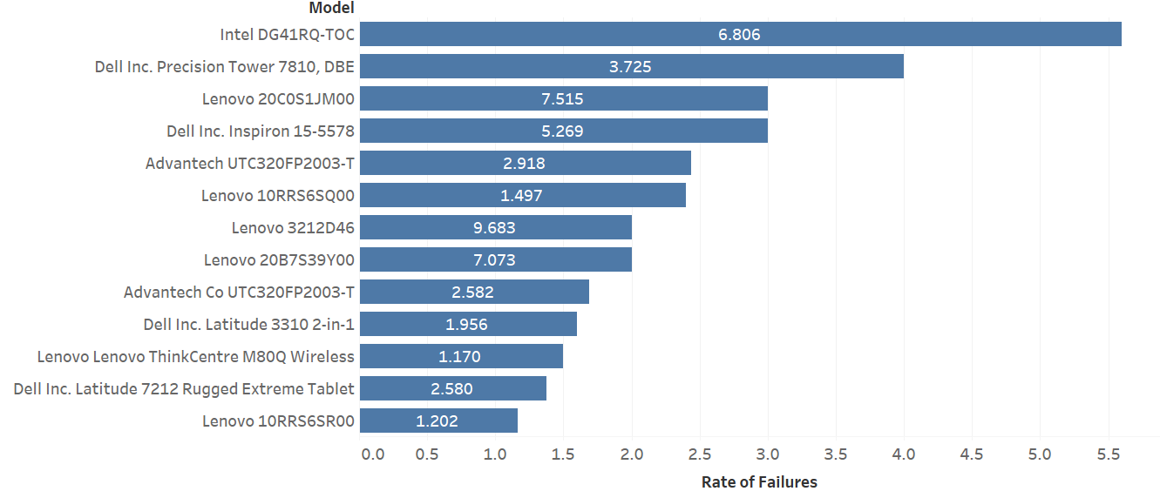
MODELS WITH HIGH FAILURE RATE

Slide 24
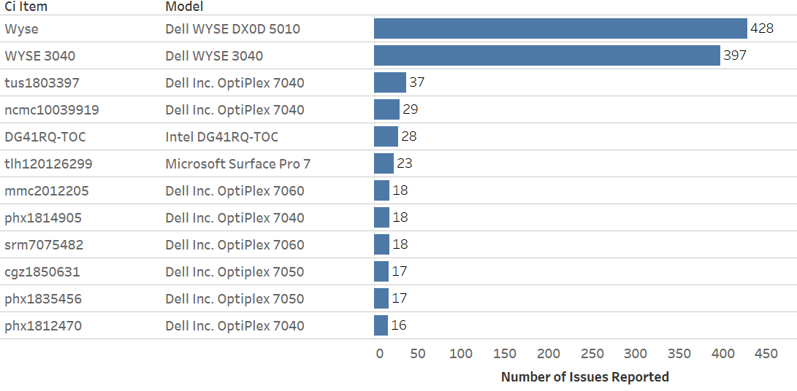
CI ITEMS WITH MAXIMUM REPORTED ISSUES

Slide 25
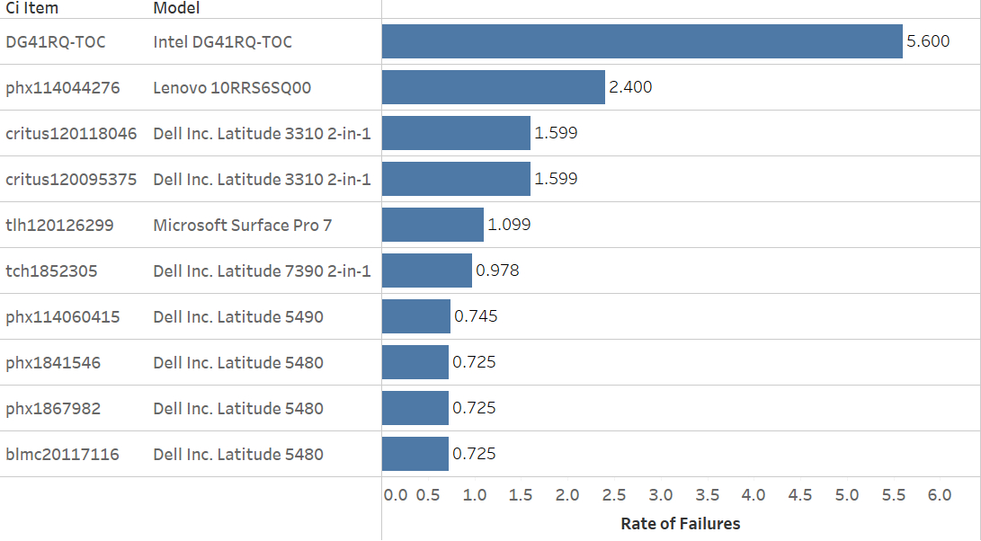
CI ITEMS WITH HIGH RATES OF FAILURE

Slide 26
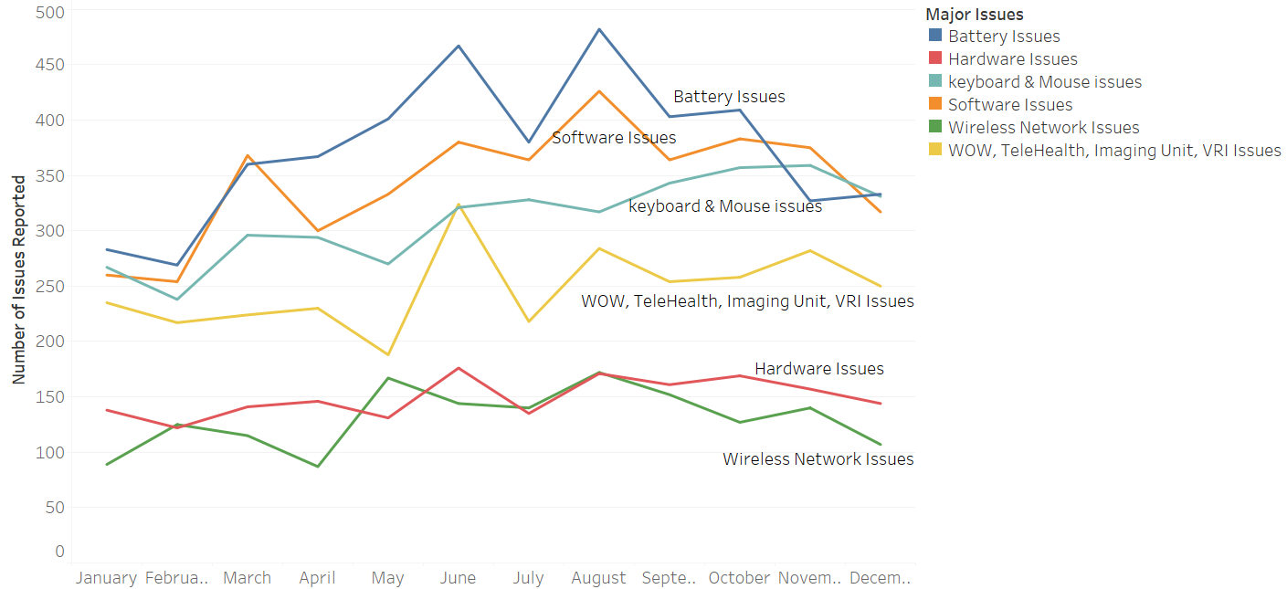
PATTERNS IN FAILURES

Slide 27
Recommendations

Slide 28



STREAMLINING THE PROCESS
REFINED EMPLOYEE TRAINING
TICKETING SYSTEM IMPROVEMENTS
OPTIMIZING
ASSET MANAGEMENT

Slide 29



1. REFINED EMPLOYEE TRAINING
MANDATORY
TRAINING
KNOWLEDGE
BASE
TRAINING
VIDEOS

Slide 30



2. TICKETING SYSTEM IMPROVEMENTS
SUBCATEGORIES
IN TICKETS
KEEPING TICKETS
UP TO DATE
AUTOMATIC
RESPONSES

Slide 31



3. ASSET MANAGEMENT OPTIMIZATION
IMPLEMENT A
UNIFIED SYSTEM
RECORD & TRACK
FAILURES & FIXES
MICROSOFT
INTUNE

Slide 32
Implementation

Slide 33




STRATEGIC IMPLEMENTATION
EMPLOYEE TRAINING
Design knowledge base for training programs
Design Knowledge Base
Anticipated Duration
8 MONTHS
Start trainings as a certification course for few employees and collect feedback
Mandatory Trainings & Feedback
Implement mandatory annual training across Banner Health
Mandatory Annual Training

Slide 34
STRATEGIC IMPLEMENTATION
TICKETING SYSTEM
Adding sub-categories (Examples: Teams, Bitlocker etc. under software classification)
Sub-Categories
Anticipated Duration
9 MONTHS
IT supports reviews & updates tickets that are raised in incorrect categories
IT Support Updating
Implement an automated response system where users receive steps to troubleshoot frequent issues themselves
Automated Response

Slide 35
STRATEGIC IMPLEMENTATION
ASSET MANAGEMENT
Tracking all devices from inception to end of life
Unified System
Anticipated Duration
9 MONTHS
Record Failures and Fixes
Fix and document common issues reported for all devices
Implement & integrate Intune asset management system
Microsoft Intune

Slide 36
STRATEGIC IMPLEMENTATION ROADMAP
Timeline
1-3 Months
3-6 Months
6-9 Months
Design Knowledge Base
Employee
Training
Implement Trainings as a Pilot Project
Roll out Mandatory Training
Tracking all Devices in a Unified System
Asset Management
Implementation of Intune
Record Failures and Fixes
Adding Additional Categories in
ServiceNow System and Testing New Features
Ticketing System
Inculcate the Knowledge Base into the Ticketing System

Slide 37
Cost & Savings

Slide 38


CURRENT COST OF RESOLUTION
$30/hr.
Fixing Cost
42,993
Total Issues
$1,289,790
Total Resolution Cost
60 mins
Avg. Resolution Time

Slide 39














YEAR 1: ESTIMATED COST VS. SAVINGS
Robust Ticketing
System
Employee Training
Asset Management
Full Implementation
Recommendation
% Reduction in Issues
~17K
Reduction in Issues
25%
24%
30%
Reduction in Issues
32,245
38,694
36,544
42,993 – 25% of 42,993
40 mins
Average Resolution Time
Cost Estimate
$967,343
$1,160,811
$1,096,322
32,245 x $30
Implementation Cost
$30,000
$10,000
$50,000
$773k
Estimate Savings
Total Cost Savings: Year 1
$1,289,790 - $967,343
- $30,000
$292,448
$299,550
$336,937
*Include industry-based estimates
Click here for Pro Forma

Slide 40


POTENTIAL REDUCTIONS AND SAVINGS
Total Issues
Issue Fixing Cost
Total Costs
39.9%
33.3%
59%
42k
25k
$30
$20
$1.2M
$516k
$773k
Estimated Savings
127.3%
Anticipated ROI
Click here for Pro Forma

Slide 41
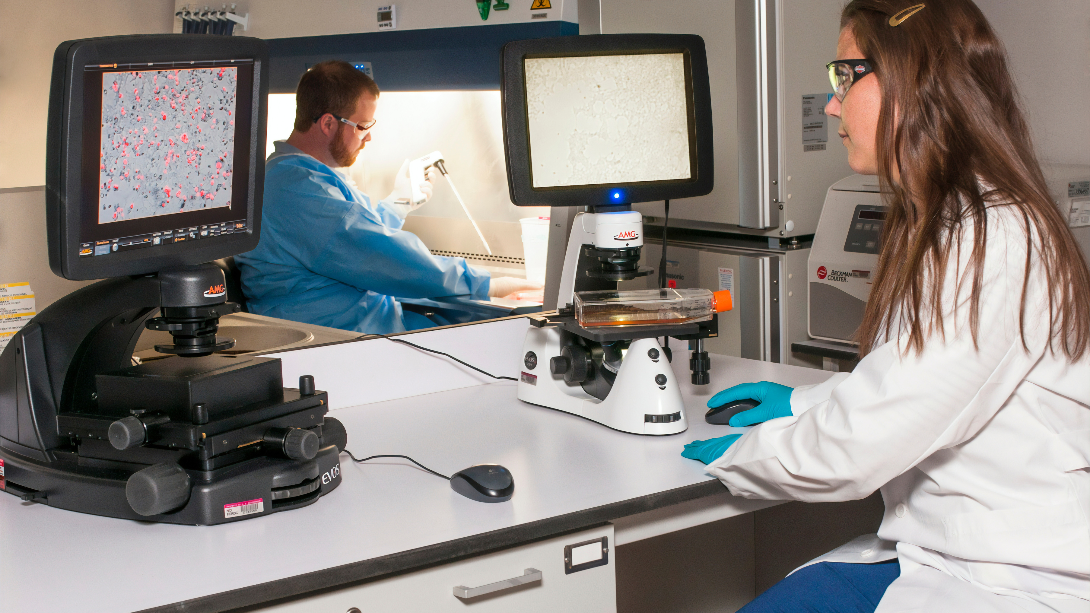

FINAL REFLECTIONS
Research Phase
Data Analysis Phase
Implementation Phase
Gathering Information
Working with Imperfect Data
Developing Strategic Roadmap
Learning Tableau
Storytelling with Data
Estimating Cost Reduction

Slide 42

Making health care easier, so life can be better!
Thank You!

Slide 43
BACK UP SLIDES

Slide 44
COST SAVINGS PRO FORMA
Total Number of Issues | 42,993
Cost of Fixing | $30/hr.
Total Current Cost | 42,993 x $30 = $1,289,790
Recommendation | % Reduction in Issues | Reduction in Issues | Estimated Implementation Cost | Estimated Cost of Fixing Issue | Total Savings
Ticketing System | 25% | 42,993 - 25% of 42,993 = 32,245 | $30,000 | 32,245 x $30 = $967,343 | $1,289,790 - $30,000 - $967,343 = $292,448
Employee Training | 24% | 42,993 - 24% of 42,993 = 32,675 | $10,000 | 32,675 x $30 = $980,240 | $1,289,790 - $10,000 - $980,240 = $299,550
Asset Management | 30% | 42,993 - 30% of 42,993 = 30,095 | $50,000 | 30,095 x $30 = $902,853 | $1,289,790 - $50,000 - $902,853 = $336,937
*Include industry-based estimates

Slide 45
COST SAVINGS PRO FORMA
Total % Reduction in Issues | (1 - 25%) x ( 1- 24%) x (1 - 30%) = 39.9%
Total Endpoint Issues | (1 - 39.9%) x 42,993 = 25,838
Avg. Resolution Time Reduction | 60 mins --> 40 mins
New Cost of Fixing | ($30 x 40 mins)/(60 mins) = $20
Cost of Fixing these Issues | 25,838x $20 = $516,775
Savings | $1,289,790 - $516,775 = $773,014
% Reduction in Cost | ($1,286,790 - $516,775)/$1,286,790) = 59.93%
ROI | $773,014/($30,000+$10,000+$50,000+$516,775) X 100% = 127.39%
Principle of Inclusion-Exclusion
To Evaluate
Total Costs & Savings

Slide 46


FINDING THE COMMONALITY
Device ID
Device ID
Location
Device User
SCM Endpoint Data
Smart
Hardware Failure
Failure Type
Device Model
Description
Operating System
Device ID
Purchase History
Endpoint TPM Failures
Device ID
Device Model
Device User
Device Brand
Device Model
Date of Purchase
Operating System

Slide 47
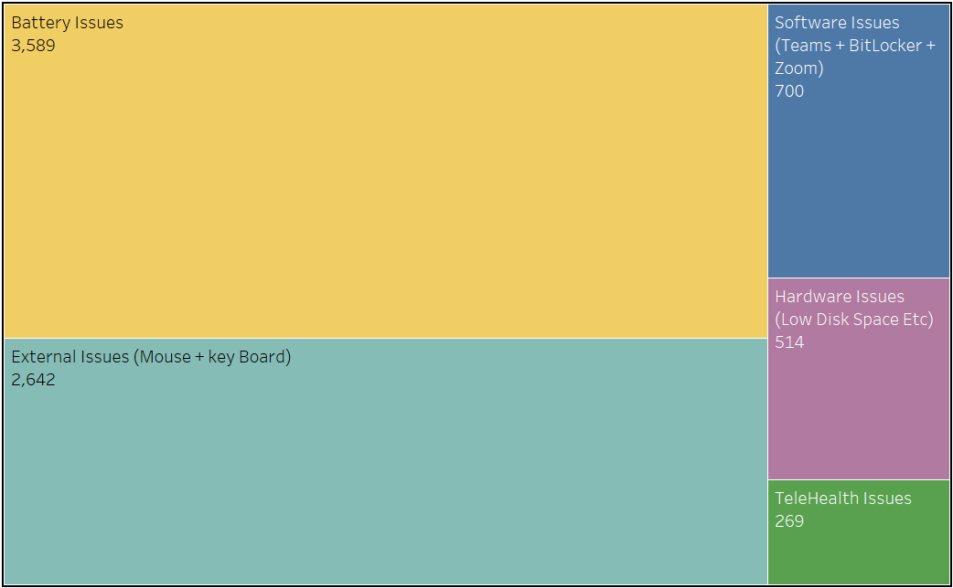
RECLASSIFYING ISSUES
VIHARI
31

Slide 48

DETERMINING RATE OF FAILURE
Number of Issues Reported per model
Rate of failure
Total Number of Device models
VIHARI
31

